Slide 1
EU VALUES AND PARTICIPATION IN DEMOCRATIC LIFE
2023
2023
The European Commission's support for the production of this publication does not constitute an endorsement of the contents, which reflect the views only of the authors, and the Commission cannot be held responsible for any use which may be made of the information contained therein.
Agreement Number: 2021-1-AT01-KA210-VET-000034603
www.eu365.eu

Slide 2
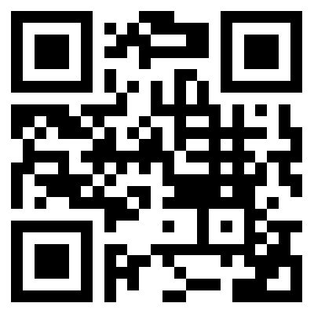
Democracy has the power to quickly spread, but its erosion can happen just as fast. Democracy is freedom. We need to stand up for it.
Ursula von der Leyen
2021
January
2023
Mon | Tue | Wed | Thu | Fri | Sat | Sun
 |  |  |  |  |  | 1
2 | 3 | 4 | 5 | 6 | 7 | 8
9 | 10 | 11 | 12 | 13 | 14 | 15
16 | 17 | 18 | 19 | 20 | 21 | 22
23 | 24 | 25 | 26 | 27 | 28 | 29
30 | 31
www.eu365.eu

Slide 3
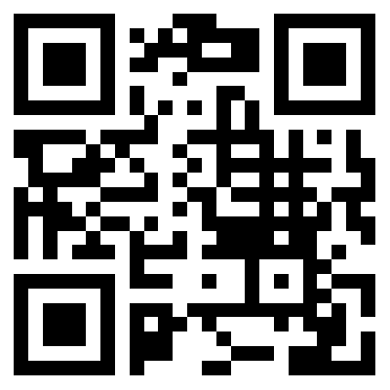
The EU Charter of
Fundamental Rights ensures the freedom of movement and gives citizens the right to move and reside freely within the Union.
European Commission
2012
[adapted]
February
2023
Mon | Tue | Wed | Thu | Fri | Sat | Sun
 |  | 1 | 2 | 3 | 4 | 5
6 | 7 | 8 | 9 | 10 | 11 | 12
13 | 14 | 15 | 16 | 17 | 18 | 19
20 | 21 | 22 | 23 | 24 | 25 | 26
27 | 28
www.eu365.eu

Slide 4
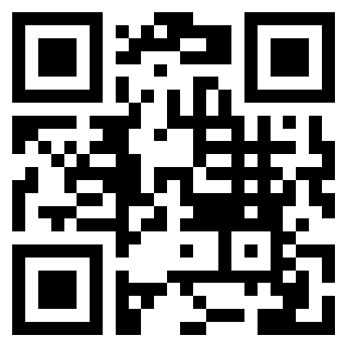
The EU Charter of
Fundamental Rights
protects individual freedoms
such as respect for private life,
freedom of thought, religion, assembly, expression and information.
European Commission
March
2023
Mon | Tue | Wed | Thu | Fri | Sat | Sun
 |  | 1 | 2 | 3 | 4 | 5
6 | 7 | 8 | 9 | 10 | 11 | 12
13 | 14 | 15 | 16 | 17 | 18 | 19
20 | 21 | 22 | 23 | 24 | 25 | 26
27 | 28 | 29 | 30 | 31
www.eu365.eu

Slide 5
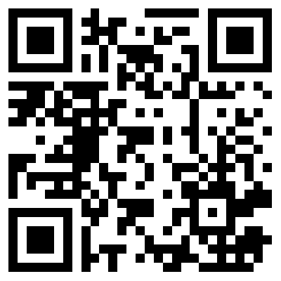
Human dignity is inviolable.
It must be respected, protected
and constitutes the real basis of fundamental rights.
European Commission
April
2023
Mon | Tue | Wed | Thu | Fri | Sat | Sun
 |  |  |  |  | 1 | 2
3 | 4 | 5 | 6 | 7 | 8 | 9
10 | 11 | 12 | 13 | 14 | 15 | 16
17 | 18 | 19 | 20 | 21 | 22 | 23
24 | 25 | 26 | 27 | 28 | 29 | 30
www.eu365.eu

Slide 6
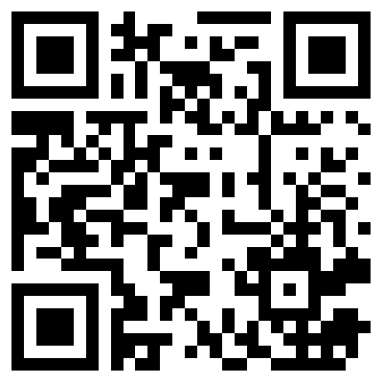
A European citizen automatically
enjoys political rights.
Every adult EU citizen has the
right to stand as a candidate
and to vote in elections
to the European Parliament.
European Commission
May
2023
Mon | Tue | Wed | Thu | Fri | Sat | Sun
1 | 2 | 3 | 4 | 5 | 6 | 7
8 | 9 | 10 | 11 | 12 | 13 | 14
15 | 16 | 17 | 18 | 19 | 20 | 21
22 | 23 | 24 | 25 | 26 | 27 | 28
29 | 30 | 31
www.eu365.eu

Slide 7
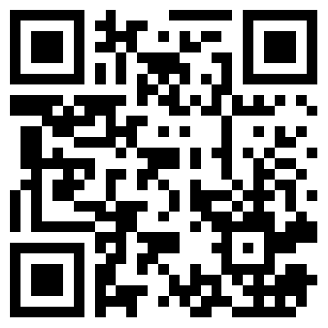
Europe was founded as a community bound together by solidarity.
Martin Schulz
June
2023
Mon | Tue | Wed | Thu | Fri | Sat | Sun
 |  |  | 1 | 2 | 3 | 4
5 | 6 | 7 | 8 | 9 | 10 | 11
12 | 13 | 14 | 15 | 16 | 17 | 18
19 | 20 | 21 | 22 | 23 | 24 | 25
26 | 27 | 28 | 29 | 30
www.eu365.eu

Slide 8
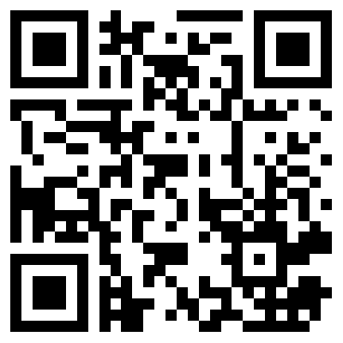
The
EU Charter of Fundamental Rights protects human rights;
the right to be free from discrimination, the right to the
protection of your personal
data, and the right to
access justice.
European Commission
[adapted]
July
2023
Mon | Tue | Wed | Thu | Fri | Sat | Sun
 |  |  |  |  | 1 | 2
3 | 4 | 5 | 6 | 7 | 8 | 9
10 | 11 | 12 | 13 | 14 | 15 | 16
17 | 18 | 19 | 20 | 21 | 22 | 23
24 | 25 | 26 | 27 | 28 | 29 | 30
31
www.eu365.eu

Slide 9
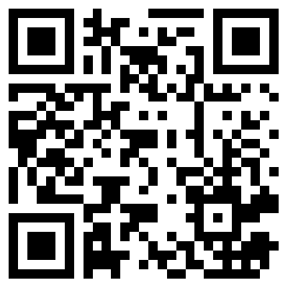
The
European Union
is the world's most successful invention for advancing
peace.
John Bruton
2012
August
2023
Mon | Tue | Wed | Thu | Fri | Sat | Sun
 | 1 | 2 | 3 | 4 | 5 | 6
7 | 8 | 9 | 10 | 11 | 12 | 13
14 | 15 | 16 | 17 | 18 | 19 | 20
21 | 22 | 23 | 24 | 25 | 26 | 27
28 | 29 | 30 | 31
www.eu365.eu

Slide 10
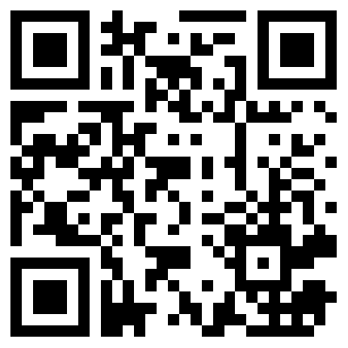
Only the people
can change and enrich things
in the institutions and transmit them to future generations.
John Bruton
2012
September
2023
Mon | Tue | Wed | Thu | Fri | Sat | Sun
 |  |  |  | 1 | 2 | 3
4 | 5 | 6 | 7 | 8 | 9 | 10
11 | 12 | 13 | 14 | 15 | 16 | 17
18 | 19 | 20 | 21 | 22 | 23 | 24
25 | 26 | 27 | 28 | 29 | 30
www.eu365.eu

Slide 11
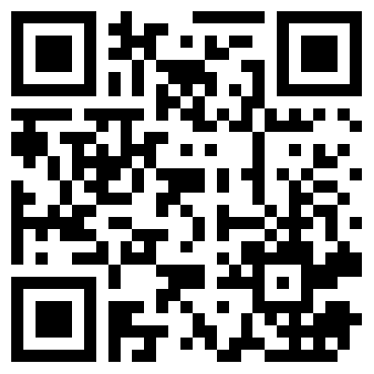
Europe’s Destiny and the
future of the free world
are entirely in our hands.
Simone Veil
1982
October
2023
Mon | Tue | Wed | Thu | Fri | Sat | Sun
 |  |  |  |  |  | 1
2 | 3 | 4 | 5 | 6 | 7 | 8
9 | 10 | 11 | 12 | 13 | 14 | 15
16 | 17 | 18 | 19 | 20 | 21 | 22
23 | 24 | 25 | 26 | 27 | 28 | 29
30 | 31
www.eu365.eu

Slide 12
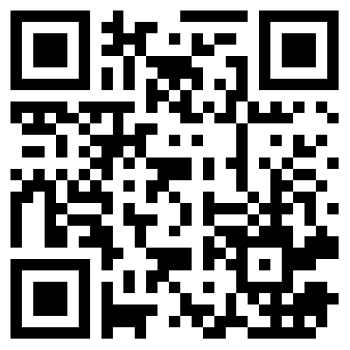
Europe.
The art of the possible.
Jacques Chirac
2016
[adapted]
November
2023
Mon | Tue | Wed | Thu | Fri | Sat | Sun
 |  | 1 | 2 | 3 | 4 | 5
6 | 7 | 8 | 9 | 10 | 11 | 12
13 | 14 | 15 | 16 | 17 | 18 | 19
20 | 21 | 22 | 23 | 24 | 25 | 26
27 | 28 | 29 | 30
www.eu365.eu

Slide 13
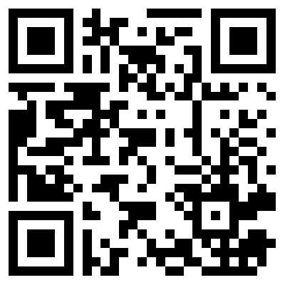
The future will not be built
through force, nor the desire to conquer, but by the patient application of the democratic method, the constructive spirit of agreement, and by
respect for freedom.
Alcide De Gasperi
2020
December
2023
Mon | Tue | Wed | Thu | Fri | Sat | Sun
 |  |  |  | 1 | 2 | 3
4 | 5 | 6 | 7 | 8 | 9 | 10
11 | 12 | 13 | 14 | 15 | 16 | 17
18 | 19 | 20 | 21 | 22 | 23 | 24
25 | 26 | 27 | 28 | 29 | 30 | 31
www.eu365.eu

Slide 14
GREEN AND ENVIRONMENTALLY-FRIENDLY LIFESTYLES
2023
2023
The European Commission's support for the production of this publication does not constitute an endorsement of the contents, which reflect the views only of the authors, and the Commission cannot be held responsible for any use which may be made of the information contained therein.
Agreement Number: 2021-1-AT01-KA210-VET-000034603
www.eu365.eu

Slide 15
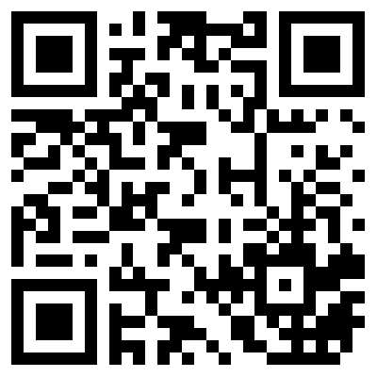
The EU goal is to reconcile the economy with our planet,
to reconcile the way
we produce and the way we consume with our planet and to make it work for our people.
Ursula von der Leyen
2019
January
Mon | Tue | Wed | Thu | Fri | Sat | Sun
 |  |  |  |  |  | 1
2 | 3 | 4 | 5 | 6 | 7 | 8
9 | 10 | 11 | 12 | 13 | 14 | 15
16 | 17 | 18 | 19 | 20 | 21 | 22
23 | 24 | 25 | 26 | 27 | 28 | 29
30 | 31
2023
www.eu365.eu

Slide 16
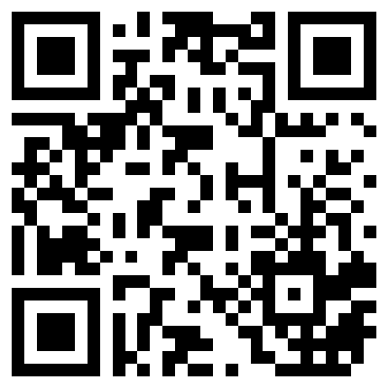
The European Green Deal is our new growth strategy – for a growth that gives back more than it takes away.
Ursula von der Leyen
2021
February
Mon | Tue | Wed | Thu | Fri | Sat | Sun
 |  | 1 | 2 | 3 | 4 | 5
6 | 7 | 8 | 9 | 10 | 11 | 12
13 | 14 | 15 | 16 | 17 | 18 | 19
20 | 21 | 22 | 23 | 24 | 25 | 26
27 | 28
2023
www.eu365.eu

Slide 17
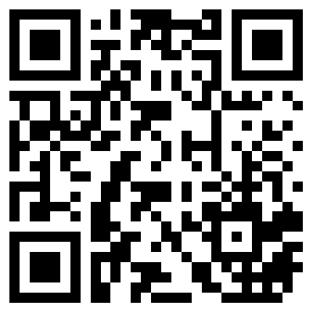
The Sustainable
Development Goals are a call for action by all countries
– poor, rich and middle-income – to promote prosperity while protecting the planet.
United Nations
March
2023
Mon | Tue | Wed | Thu | Fri | Sat | Sun
 |  | 1 | 2 | 3 | 4 | 5
6 | 7 | 8 | 9 | 10 | 11 | 12
13 | 14 | 15 | 16 | 17 | 18 | 19
20 | 21 | 22 | 23 | 24 | 25 | 26
27 | 28 | 29 | 30 | 31
www.eu365.eu

Slide 18
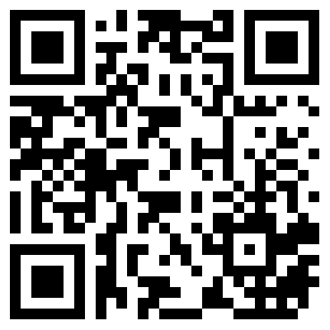
By using the
European Green Deal as our compass, we can turn the crisis into an opportunity to rebuild our economies differently and make them more resilient.
Ursula von der Leyen
2020
[adapted]
April
Mon | Tue | Wed | Thu | Fri | Sat | Sun
 |  |  |  |  | 1 | 2
3 | 4 | 5 | 6 | 7 | 8 | 9
10 | 11 | 12 | 13 | 14 | 15 | 16
17 | 18 | 19 | 20 | 21 | 22 | 23
24 | 25 | 26 | 27 | 28 | 29 | 30
2023
www.eu365.eu

Slide 19
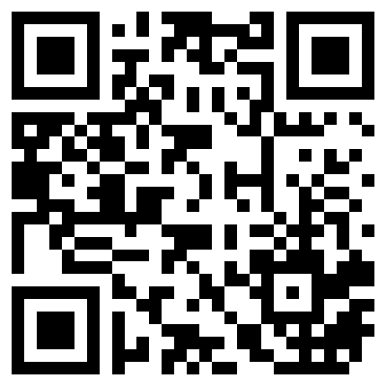
Vocational Education
and Training is an enabler of innovation and an essential foundation for green, digital and sustainable growth.
Osnabrück Declaration
2020
May
Mon | Tue | Wed | Thu | Fri | Sat | Sun
1 | 2 | 3 | 4 | 5 | 6 | 7
8 | 9 | 10 | 11 | 12 | 13 | 14
15 | 16 | 17 | 18 | 19 | 20 | 21
22 | 23 | 24 | 25 | 26 | 27 | 28
29 | 30 | 31
2023
www.eu365.eu

Slide 20
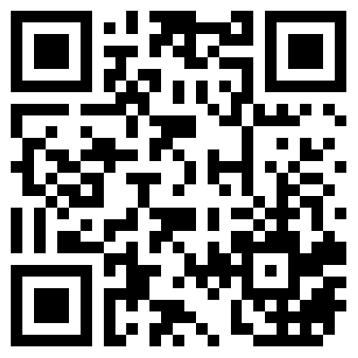
We can make our
society and our planet healthier by investing in renewable energy, by buying sustainable food, reusing materials and producing low carbon steel.
Ursula van der Leyen
2020
June
Mon | Tue | Wed | Thu | Fri | Sat | Sun
 |  |  | 1 | 2 | 3 | 4
5 | 6 | 7 | 8 | 9 | 10 | 11
12 | 13 | 14 | 15 | 16 | 17 | 18
19 | 20 | 21 | 22 | 23 | 24 | 25
26 | 27 | 28 | 29 | 30
2023
www.eu365.eu

Slide 21
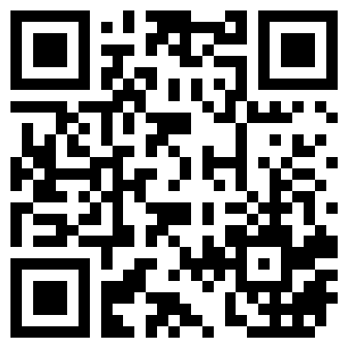
Business has a role
to play in delivering on the
goals and targets of the SDGs, leveraging their resources, innovation ability, scale and reach to do so.
Davy Horizons
2021
July
Mon | Tue | Wed | Thu | Fri | Sat | Sun
 |  |  |  |  | 1 | 2
3 | 4 | 5 | 6 | 7 | 8 | 9
10 | 11 | 12 | 13 | 14 | 15 | 16
17 | 18 | 19 | 20 | 21 | 22 | 23
24 | 25 | 26 | 27 | 28 | 29 | 30
31
2023
www.eu365.eu

Slide 22
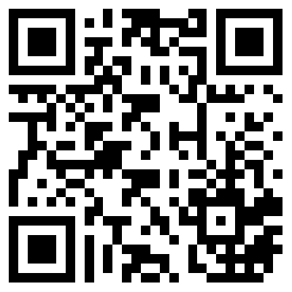
The green sector offers enormous potential for job creation and we have to make sure Europe can harvest its benefits in full.
Connie Hedegaard
August
Mon | Tue | Wed | Thu | Fri | Sat | Sun
 | 1 | 2 | 3 | 4 | 5 | 6
7 | 8 | 9 | 10 | 11 | 12 | 13
14 | 15 | 16 | 17 | 18 | 19 | 20
21 | 22 | 23 | 24 | 25 | 26 | 27
28 | 29 | 30 | 31
2023
www.eu365.eu

Slide 23
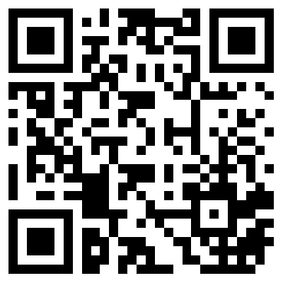
Do not wait for extraordinary circumstances to do good actions; try to use ordinary situations.
Jean-Paul Richter
September
Mon | Tue | Wed | Thu | Fri | Sat | Sun
 |  |  |  | 1 | 2 | 3
4 | 5 | 6 | 7 | 8 | 9 | 10
11 | 12 | 13 | 14 | 15 | 16 | 17
18 | 19 | 20 | 21 | 22 | 23 | 24
25 | 26 | 27 | 28 | 29 | 30
2023
www.eu365.eu

Slide 24
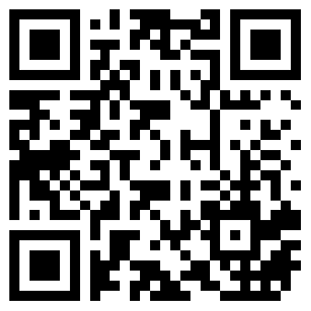
The fight to contain climate change should be our priority,
and this requires a
commitment from
everyone.
Marta Cañada
2022
October
Mon | Tue | Wed | Thu | Fri | Sat | Sun
 |  |  |  |  |  | 1
2 | 3 | 4 | 5 | 6 | 7 | 8
9 | 10 | 11 | 12 | 13 | 14 | 15
16 | 17 | 18 | 19 | 20 | 21 | 22
23 | 24 | 25 | 26 | 27 | 28 | 29
30 | 31
2023
www.eu365.eu

Slide 25
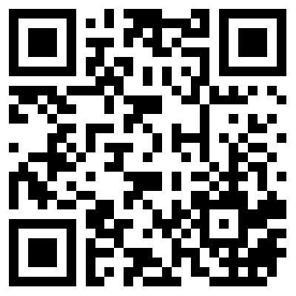
You must unite behind the science. You must take action. You must do the impossible. Because giving up can never be an option.
Greta Thunberg
2019
November
Mon | Tue | Wed | Thu | Fri | Sat | Sun
 |  | 1 | 2 | 3 | 4 | 5
6 | 7 | 8 | 9 | 10 | 11 | 12
13 | 14 | 15 | 16 | 17 | 18 | 19
20 | 21 | 22 | 23 | 24 | 25 | 26
27 | 28 | 29 | 30
2023
www.eu365.eu

Slide 26
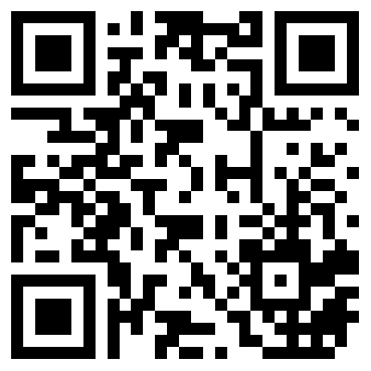
Emission reduction and
green recovery cannot be further postponed. The time for climate action is now. The way forward is together.
Massimo di Tria
2022
December
Mon | Tue | Wed | Thu | Fri | Sat | Sun
 |  |  |  | 1 | 2 | 3
4 | 5 | 6 | 7 | 8 | 9 | 10
11 | 12 | 13 | 14 | 15 | 16 | 17
18 | 19 | 20 | 21 | 22 | 23 | 24
25 | 26 | 27 | 28 | 29 | 30 | 31
2023
www.eu365.eu

Slide 27
DIVERSITY AND INCLUSION
2023
2023
The European Commission's support for the production of this publication does not constitute an endorsement of the contents, which reflect the views only of the authors, and the Commission cannot be held responsible for any use which may be made of the information contained therein.
Agreement Number: 2021-1-AT01-KA210-VET-000034603
www.eu365.eu

Slide 28
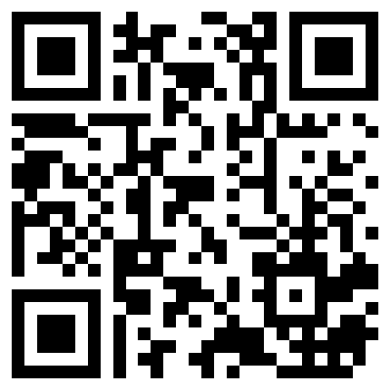
Equality is about equal rights for all citizens before the law. The principle of equality between women and men underpins all European policies and is the basis for European integration. It applies in all areas.
European Commission
January
2023
Mon | Tue | Wed | Thu | Fri | Sat | Sun
 |  |  |  |  |  | 1
2 | 3 | 4 | 5 | 6 | 7 | 8
9 | 10 | 11 | 12 | 13 | 14 | 15
16 | 17 | 18 | 19 | 20 | 21 | 22
23 | 24 | 25 | 26 | 27 | 28 | 29
30 | 31
www.eu365.eu

Slide 29
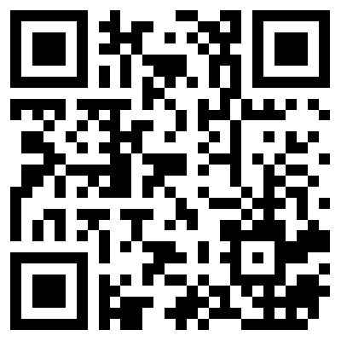
Engage with your own prejudices. Learn how to stand up and say things that won’t make you popular and be an ally to other people. Empathy is important.
Fiona Bartels-Ellis
2018
February
2023
Mon | Tue | Wed | Thu | Fri | Sat | Sun
 |  | 1 | 2 | 3 | 4 | 5
6 | 7 | 8 | 9 | 10 | 11 | 12
13 | 14 | 15 | 16 | 17 | 18 | 19
20 | 21 | 22 | 23 | 24 | 25 | 26
27 | 28
www.eu365.eu

Slide 30
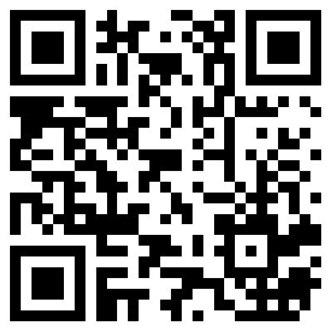
I want Europe to be at the side of women with protection and support. The time for justice and equality is now.
Ursula von der Leyen
2022
March
2023
Mon | Tue | Wed | Thu | Fri | Sat | Sun
 |  | 1 | 2 | 3 | 4 | 5
6 | 7 | 8 | 9 | 10 | 11 | 12
13 | 14 | 15 | 16 | 17 | 18 | 19
20 | 21 | 22 | 23 | 24 | 25 | 26
27 | 28 | 29 | 30 | 31
www.eu365.eu

Slide 31
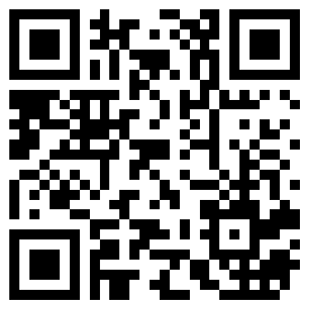
We are all citizens of one world, we are all of one blood.
To hate people because they were born in another country, because they speak a different language, or because they take a different view on this subject or that, is a great folly.
John Amos Comenius
1592-1670
April
2023
Mon | Tue | Wed | Thu | Fri | Sat | Sun
 |  |  |  |  | 1 | 2
3 | 4 | 5 | 6 | 7 | 8 | 9
10 | 11 | 12 | 13 | 14 | 15 | 16
17 | 18 | 19 | 20 | 21 | 22 | 23
24 | 25 | 26 | 27 | 28 | 29 | 30
www.eu365.eu

Slide 32
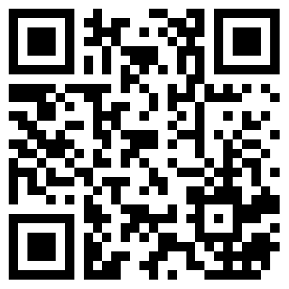
For the European Union to become a true Union of Equality we need to ensure that all people are treated equally, socially included and able to participate in social and political life without exception.
Helena Dalli
2020
[adapted]
May
2023
Mon | Tue | Wed | Thu | Fri | Sat | Sun
1 | 2 | 3 | 4 | 5 | 6 | 7
8 | 9 | 10 | 11 | 12 | 13 | 14
15 | 16 | 17 | 18 | 19 | 20 | 21
22 | 23 | 24 | 25 | 26 | 27 | 28
29 | 30 | 31
www.eu365.eu

Slide 33
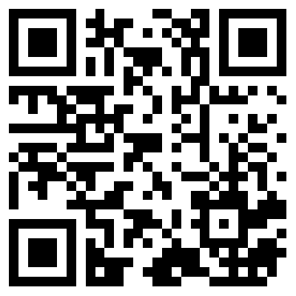
Pride events symbolise
the freedom to love and to be
who we are, united in our diversity. But to build a true #UnionOfEquality, we must support and keep on fighting
for LGBTIQ equality 24
hours a day, 7 days a week,
365 days a year!
Ursula von der Leyen
2021
June
2023
Mon | Tue | Wed | Thu | Fri | Sat | Sun
 |  |  | 1 | 2 | 3 | 4
5 | 6 | 7 | 8 | 9 | 10 | 11
12 | 13 | 14 | 15 | 16 | 17 | 18
19 | 20 | 21 | 22 | 23 | 24 | 25
26 | 27 | 28 | 29 | 30
www.eu365.eu

Slide 34
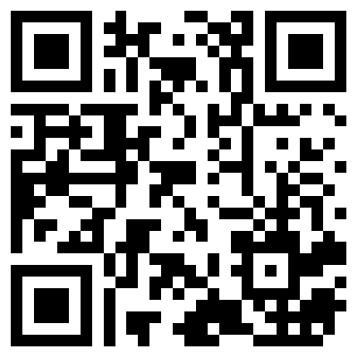
Europe itself is an embodiment of this diversity.
There is no place for racial discrimination and racism of any kind in democratic societies. We must all strive for our societies to be inclusive and tolerant.
Ulrich Beck
Helena Dalli
2020 [adapted]
July
2023
Mon | Tue | Wed | Thu | Fri | Sat | Sun
 |  |  |  |  | 1 | 2
3 | 4 | 5 | 6 | 7 | 8 | 9
10 | 11 | 12 | 13 | 14 | 15 | 16
17 | 18 | 19 | 20 | 21 | 22 | 23
24 | 25 | 26 | 27 | 28 | 29 | 30
31
www.eu365.eu

Slide 35
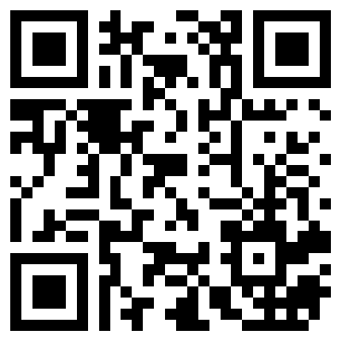
When employees are valued for who they are, they are committed to their job and fully employ their talents and creativity.
Helena Dalli
2022
August
2023
Mon | Tue | Wed | Thu | Fri | Sat | Sun
 | 1 | 2 | 3 | 4 | 5 | 6
7 | 8 | 9 | 10 | 11 | 12 | 13
14 | 15 | 16 | 17 | 18 | 19 | 20
21 | 22 | 23 | 24 | 25 | 26 | 27
28 | 29 | 30 | 31
www.eu365.eu

Slide 36
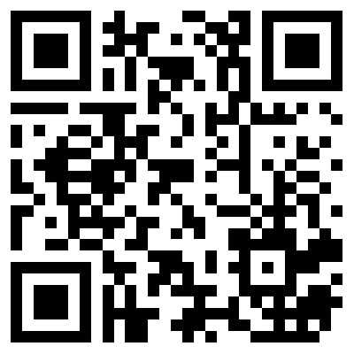
Cultural heritage brings us together. It helps strengthen social cohesion, foster tolerance and mutual understanding. The cultural and linguistic diversity of Europe, and the languages spoken are an essential part
of its cultural heritage.
Mariya Gabriel
2022
[adapted]
September
2023
Mon | Tue | Wed | Thu | Fri | Sat | Sun
 |  |  |  | 1 | 2 | 3
4 | 5 | 6 | 7 | 8 | 9 | 10
11 | 12 | 13 | 14 | 15 | 16 | 17
18 | 19 | 20 | 21 | 22 | 23 | 24
25 | 26 | 27 | 28 | 29 | 30
www.eu365.eu

Slide 37
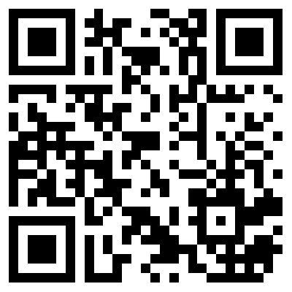
Diversity
is a value and belief that each
of us as a person has unique
gifts and skills and are able to
build and change the world.
Each of us is a very important part of the world’s puzzle.
Jana Skalková
2018
[adapted]
October
2023
Mon | Tue | Wed | Thu | Fri | Sat | Sun
 |  |  |  |  |  | 1
2 | 3 | 4 | 5 | 6 | 7 | 8
9 | 10 | 11 | 12 | 13 | 14 | 15
16 | 17 | 18 | 19 | 20 | 21 | 22
23 | 24 | 25 | 26 | 27 | 28 | 29
30 | 31
www.eu365.eu

Slide 38
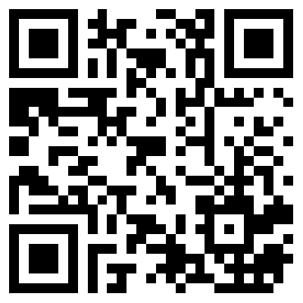
To be successful in a global society we must meet the need for diversity. Innovation is created by bringing together diverse people, with each actively participating.
Věra Jourová
2018
[adapted]
November
2023
Mon | Tue | Wed | Thu | Fri | Sat | Sun
 |  | 1 | 2 | 3 | 4 | 5
6 | 7 | 8 | 9 | 10 | 11 | 12
13 | 14 | 15 | 16 | 17 | 18 | 19
20 | 21 | 22 | 23 | 24 | 25 | 26
27 | 28 | 29 | 30
www.eu365.eu

Slide 39
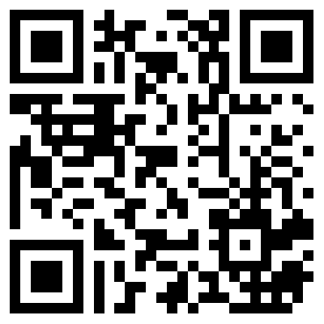
I strongly believe diversity is a journey, even if it’s a long one. It’s crucial for a modern Europe.
Jana Skalková
2018
December
2023
Mon | Tue | Wed | Thu | Fri | Sat | Sun
 |  |  |  | 1 | 2 | 3
4 | 5 | 6 | 7 | 8 | 9 | 10
11 | 12 | 13 | 14 | 15 | 16 | 17
18 | 19 | 20 | 21 | 22 | 23 | 24
25 | 26 | 27 | 28 | 29 | 30 | 31
www.eu365.eu

