Slide 1


EU VALUES AND PARTICIPATION IN DEMOCRATIC LIFE
GREEN AND ENVIRONMENTALLY-FRIENDLY LIFESTYLES
www.eu365.eu
DIVERSITY AND
INCLUSION
The European Commission's support for the production of this publication does not constitute an endorsement of the contents, which reflect the views only of the authors, and the Commission cannot be held responsible for any use which may be made of the information contained therein.
Agreement Number: 2021-1-AT01-KA210-VET-000034603
This work is licensed under a Creative Commons Attribution-NonCommercial-ShareAlike 2.0 Generic License.

Slide 2
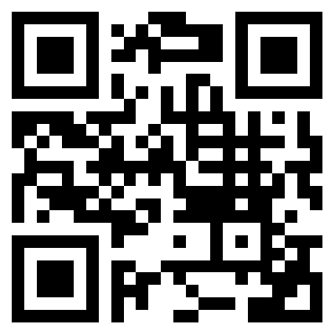

JANUARY
Democracy has the power to quickly spread, but its erosion
can happen just as fast.
Democracy is freedom.
We need to stand up for it.
01 02 03 04 05 06 07
08 09 10 11 12 13 14
15 16 17 18 19 20 21
22 23 24 25 26 27 28
29 30 31
Ursula von der Leyen
2021
www.eu365.eu

Slide 3
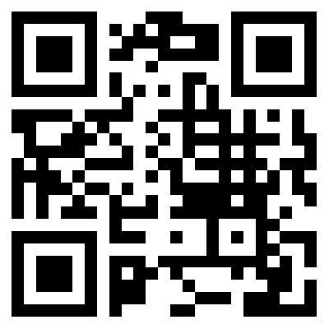
FEBRUARY
The EU Charter of
Fundamental Rights ensures the freedom of movement and gives citizens the right to move and reside freely within the Union.
01 02 03 04 05 06 07
08 09 10 11 12 13 14
15 16 17 18 19 20 21
22 23 24 25 26 27 28
29
European Commission
2012
[adapted]
www.eu365.eu

Slide 4
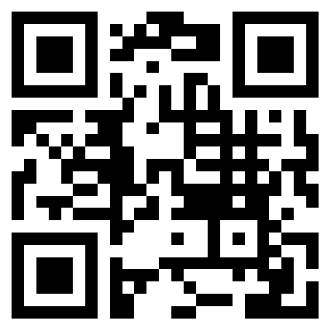
MARCH
The EU Charter of
Fundamental Rights
protects individual freedoms
such as respect for private life,
freedom of thought, religion, assembly, expression and information.
01 02 03 04 05 06 07
08 09 10 11 12 13 14
15 16 17 18 19 20 21
22 23 24 25 26 27 28
29 30 31
European Commission
www.eu365.eu

Slide 5
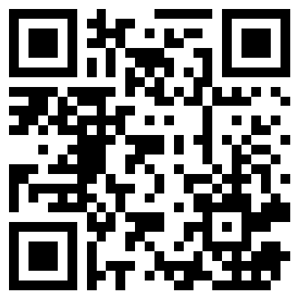
APRIL
Human dignity is inviolable.
It must be respected, protected
and constitutes the real basis of fundamental rights.
01 02 03 04 05 06 07
08 09 10 11 12 13 14
15 16 17 18 19 20 21
22 23 24 25 26 27 28
29 30
European Commission
www.eu365.eu

Slide 6
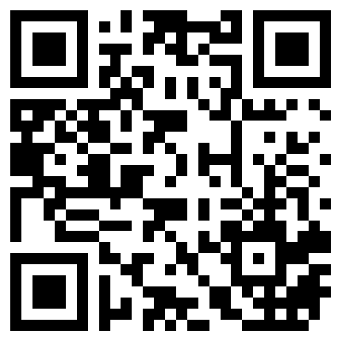
MAY
Vocational Education
and Training is an enabler of innovation and an essential foundation for green, digital and sustainable growth.
01 02 03 04 05 06 07
08 09 10 11 12 13 14
15 16 17 18 19 20 21
22 23 24 25 26 27 28
29 30 31
Osnabrück Declaration
2020
www.eu365.eu

Slide 7
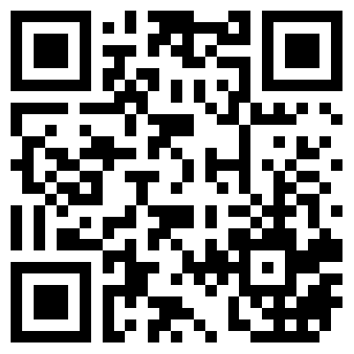
JUNE
We can make our
society and our planet healthier by investing in renewable energy, by buying sustainable food, reusing materials and producing low carbon steel.
01 02 03 04 05 06 07
08 09 10 11 12 13 14
15 16 17 18 19 20 21
22 23 24 25 26 27 28
29 30
Ursula van der Leyen
2020
www.eu365.eu

Slide 8
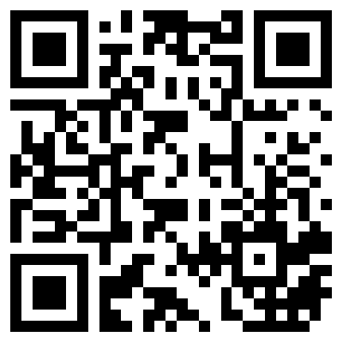
JULY
Business has a role
to play in delivering on the
goals and targets of the SDGs, leveraging their resources, innovation ability, scale and reach to do so.
01 02 03 04 05 06 07
08 09 10 11 12 13 14
15 16 17 18 19 20 21
22 23 24 25 26 27 28
29 30 31
Davy Horizons
2021
www.eu365.eu

Slide 9
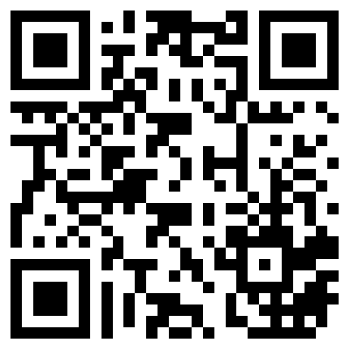
AUGUST
The green sector offers enormous potential for job creation and we have to make sure Europe can harvest its benefits in full.
01 02 03 04 05 06 07
08 09 10 11 12 13 14
15 16 17 18 19 20 21
22 23 24 25 26 27 28
29 30 31
Connie Hedegaard
www.eu365.eu

Slide 10
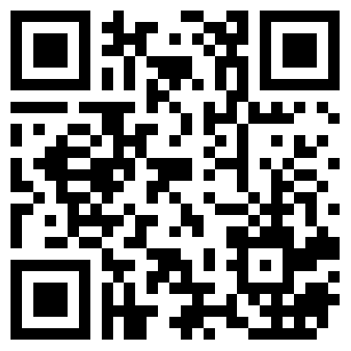
SEPTEMBER
Cultural heritage brings
us together. It helps strengthen
social cohesion, foster tolerance and mutual understanding. The cultural and linguistic diversity of Europe,
and the languages spoken are
an essential part
of its cultural heritage.
01 02 03 04 05 06 07
08 09 10 11 12 13 14
15 16 17 18 19 20 21
22 23 24 25 26 27 28
29 30
Mariya Gabriel
2022
[adapted]
www.eu365.eu

Slide 11
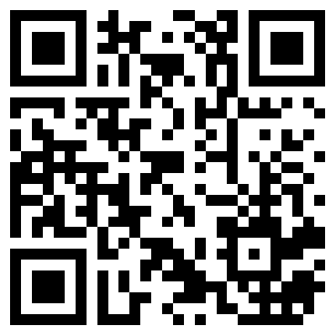
OCTOBER
Diversity
is a value and belief that each
of us as a person has unique
gifts and skills and are able to
build and change the world.
Each of us is a very important part of the world’s puzzle.
01 02 03 04 05 06 07
08 09 10 11 12 13 14
15 16 17 18 19 20 21
22 23 24 25 26 27 28
29 30 31
Jana Skalková
2018
[adapted]
www.eu365.eu

Slide 12
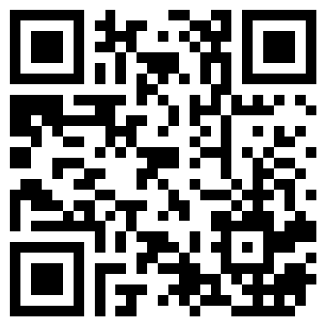
NOVEMBER
To be successful in a global
society we must meet the need
for diversity. Innovation is
created by bringing together
diverse people, with each
actively participating.
01 02 03 04 05 06 07
08 09 10 11 12 13 14
15 16 17 18 19 20 21
22 23 24 25 26 27 28
29 30
Věra Jourová
2018
[adapted]
www.eu365.eu

Slide 13
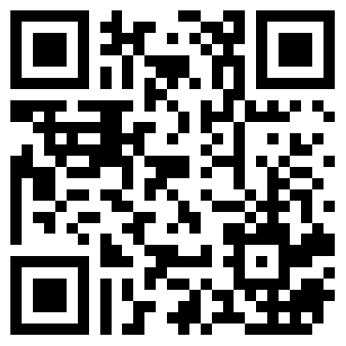
DECEMBER
I strongly believe diversity
is a journey, even if it’s a
long one. It’s crucial for a
modern Europe.
01 02 03 04 05 06 07
08 09 10 11 12 13 14
15 16 17 18 19 20 21
22 23 24 25 26 27 28
29 30 31
Jana Skalková
2018
www.eu365.eu

